Slide 1


Management Information Systems
Report
STRATEGY | EXECUTION | SUPPORT

Slide 2
Techwave AWS MIS Report for the month of Nov’17
Root
Techwave - AWS Organizations:
Sub-billing purposes and transparent expenditures on Infrastructure by Techwave Internal / External clients as depicted beside
ADMS
Techwave
Consulting
TWAWSNOC2
TWSAPDEMOS
No | Techwave Organizations | Owner | EC2 Instances Staged | Bill in $ | % of Cost
1 | TWADMS | Prabhakar Reddy Dasari | 5 | 241.22 | 9%
2 | Techwave Consulting | Cloud Solutions Team | 1 | 1.29 | 2%
3 | TWAWSNOC2 | IT Team - NOC2 | 41 | 6789.66 | 79%
4 | TWSAPDEMOS | SAP / BI / EPM / Life Sciences | 5 | 1460.24 | 10%
5 | TWIMICRON | Sridevi Voleti | 0 | 0 | 0

Slide 3
Techwave AWS MIS Report for the month of Nov’17
Cost Summary

Slide 4
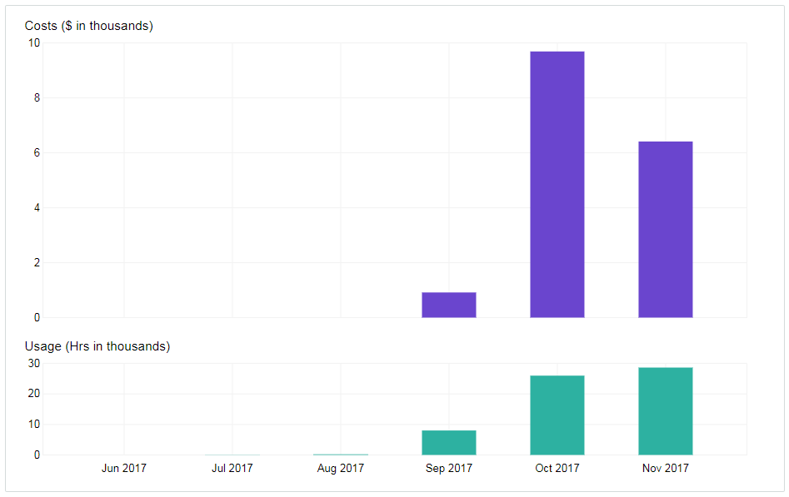


Monthly EC2 running hours costs and usage
Cost reduction post optimization even after the increase in usage hours
EC2 service utilization – Oct 2017 is $9699.89 and Nov 2017 is $6426.27
Note: Hours of utilization in fact increased from 25,983 hours in Oct 2017 to 28,629 hours in Nov 2017. Approximately 10% increase in utilization

Slide 5
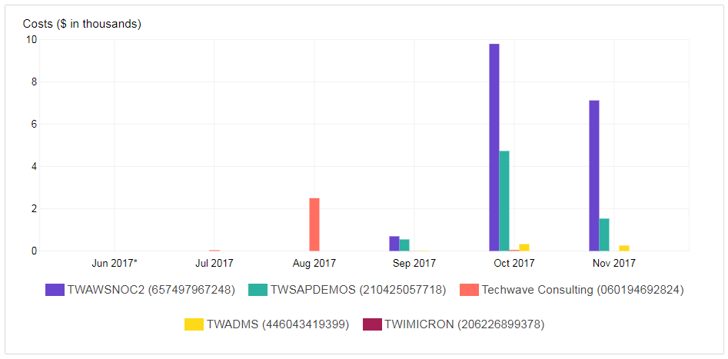
Monthly costs by linked account
Cost reduced 27%
Cost reduced 68%
TWSAPDEMOS - $4730.60 for the month of Oct 2017 and $1532.11 for the month of Nov 2017 – Cost reduced 68%
TWAWSNOC2 – $9796.17 for the month of Oct 2017 and $7122.08 for the month of Nov 2017 – Cost reduced 27%

Slide 6
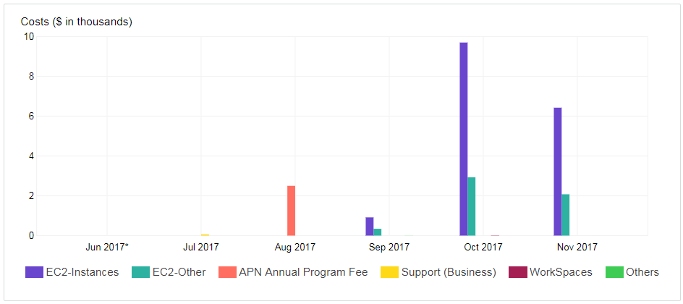
Monthly costs by service
Cost reduced to 34%
EC2 service utilization – Oct 2017 is $9699.89 and Nov 2017 is $6426.27
Note: Hours of utilization in fact increased from 25,983 hours in Oct 2017 to 28,629 hours in Nov 2017.

Slide 7
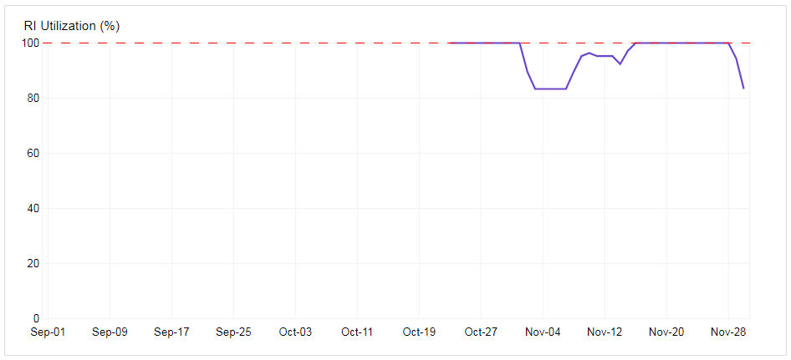
Reserved Instance Utilization
In process of defining best practices, few reserved instances were stopped to reduce number of hours usage. This resulted in utilization percentage.

Slide 8
Service Improvements
Optimization Areas:
It is observed that 4 Instances staged in TWSAPDEMOS is barely utilized. Even though these instances are stopped, the storage volumes ( approximately 3TB) are charged. We can further reduce by:
Taking machine images and moving to S3 and terminate instances along with storage volumes attached to reduce cost
As we have these images in S3, using Cloud Formation we have Infrastructure as a code to stage instances On Demand basis
Downsize the instances based on utilizations
Migrate Database instances to RDS with low cost
Storage can be moved to S3
Systems need to use:
1. Critical systems viz. Production

